Slide 1

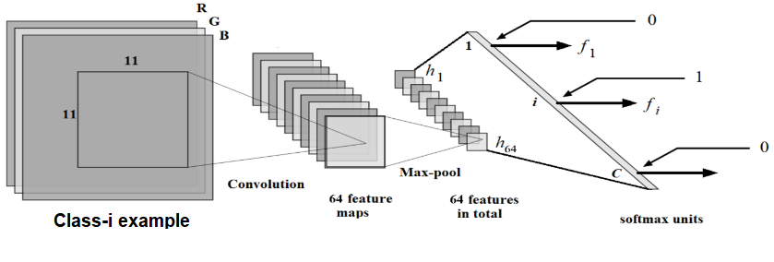
Convolutional Neural Networks (CNNs)
Dr. Olcay Kursun
AUM Computer Science
Machine Learning
Some slides are adapted from the MS theses of my students.
Convolution slides are adapted from:
http://web.cecs.pdx.edu/~mperkows/CLASS_479/lectures_2012_479/2011.%200021.%20PVIS_021_edge-detection-Sobel.ppt
Learn more at:
Ian Goodfellow and Yoshua Bengio and Aaron Courville (2016). Deep Learning, MIT Press
http://www.deeplearningbook.org

Slide 2
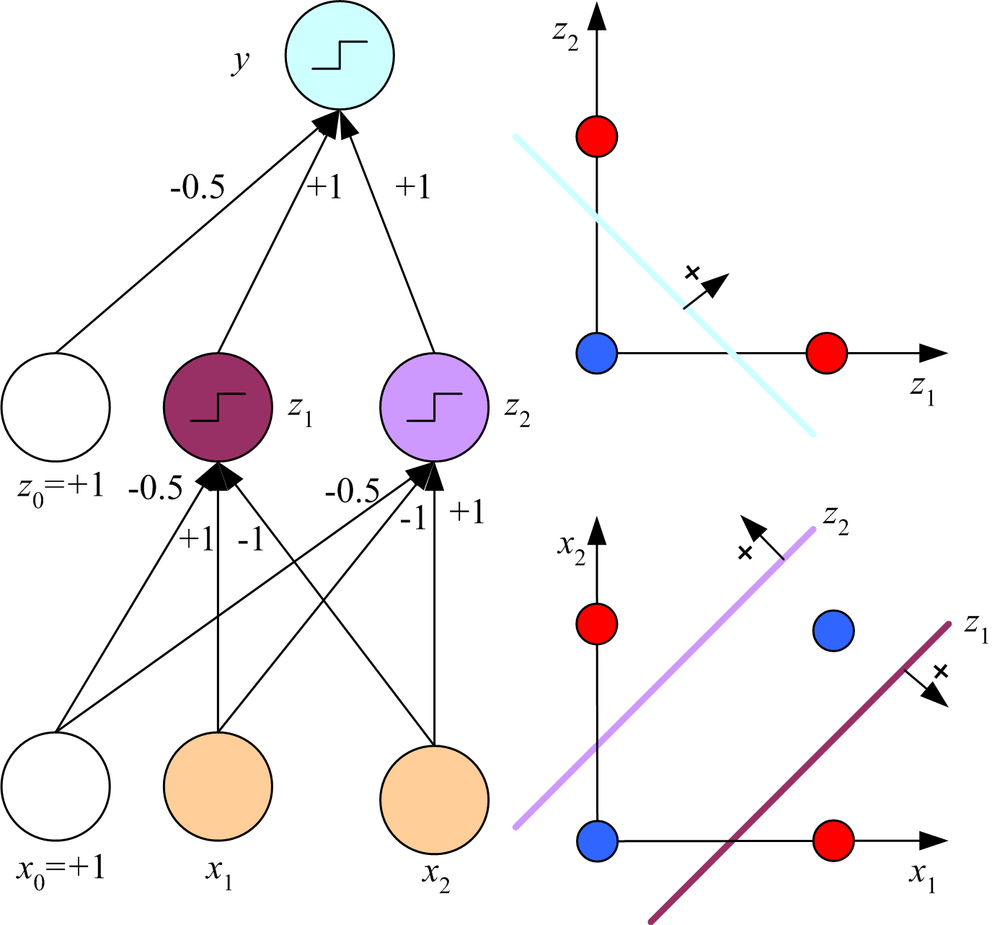
Hidden layers give us better representations (better = more linearized)
y = x₁ XOR x₂ = z₁ OR z₂
z₁ = x₁ AND ~x₂
z₂ = ~x₁ AND x₂
From the MLP lecture of Ethem Alpaydin, MIT Press

Slide 3
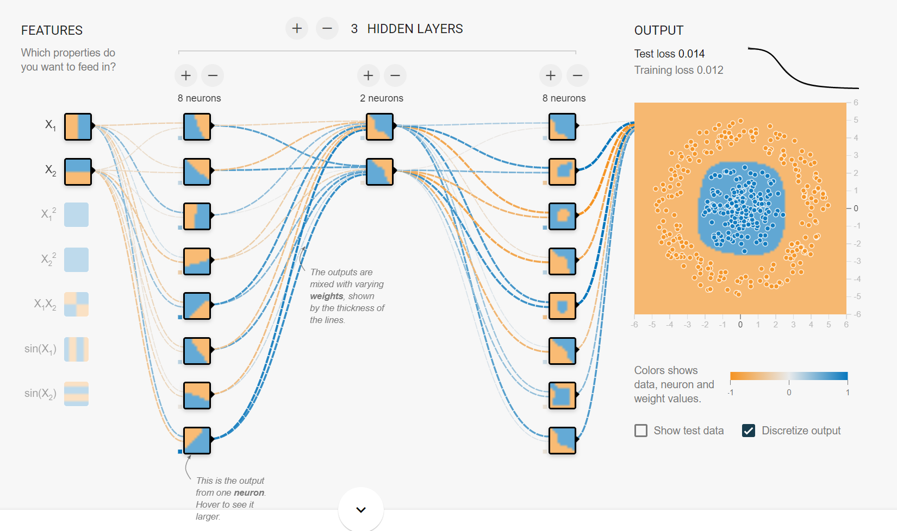
https://playground.tensorflow.org

Slide 4
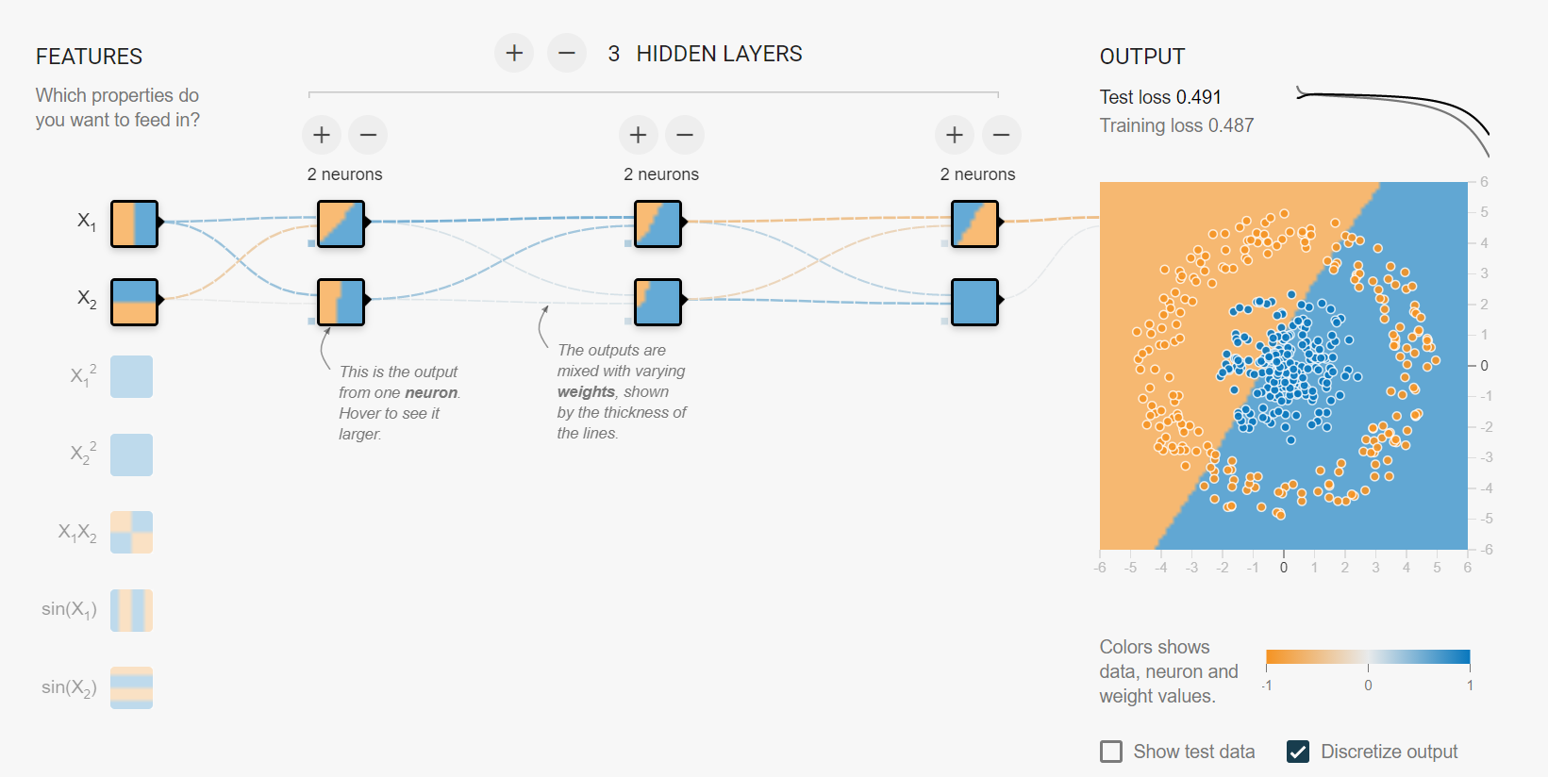
https://playground.tensorflow.org

Slide 5
CONVOLUTIONAL NEURAL NETWORKS – BUILDING BLOCKS
Convolutional Layer & ReLU
Kernels, Strides, and Padding, Feature Maps
Pooling Layer
Max-pooling and average-pooling
Fully Connected Layer (Softmax for C>2, Sigmoid for C=2)
Convergence related layers: Batch Normalization and Dropout

Slide 6
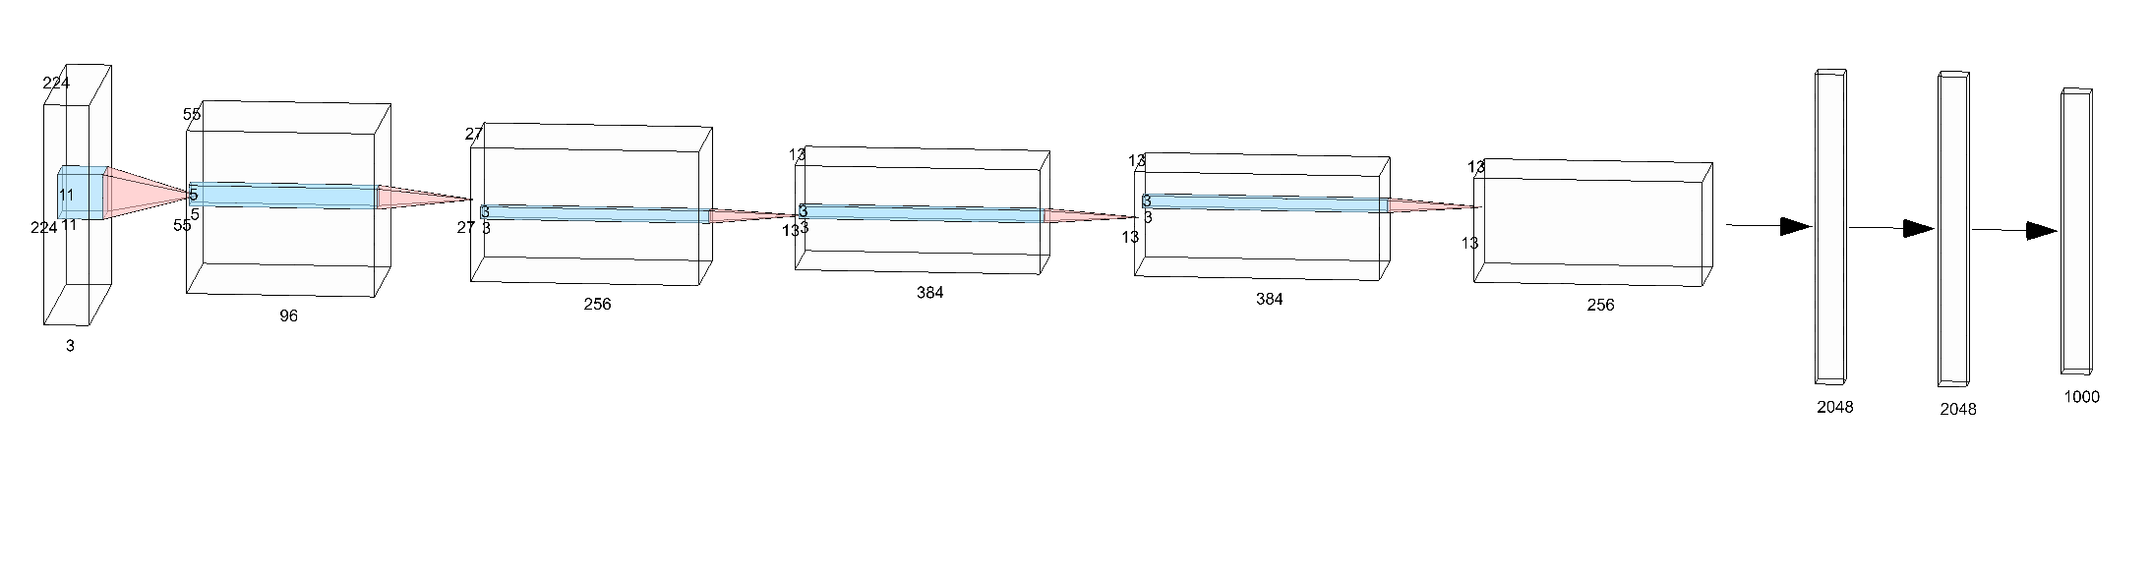
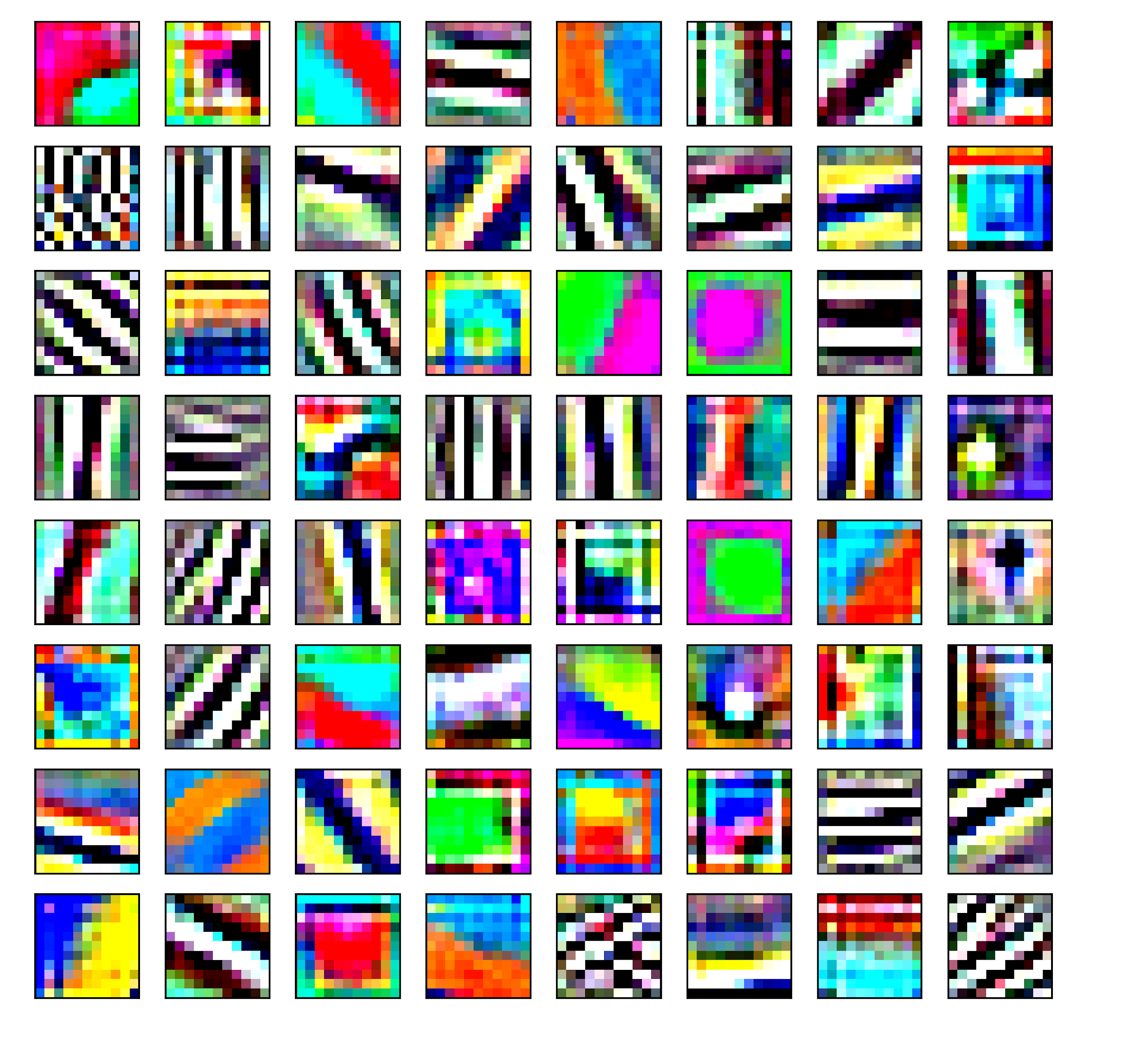
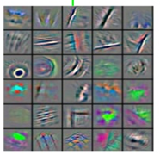
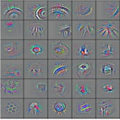
Lower-area features
Mid-Area features
Higher-area features

Slide 7
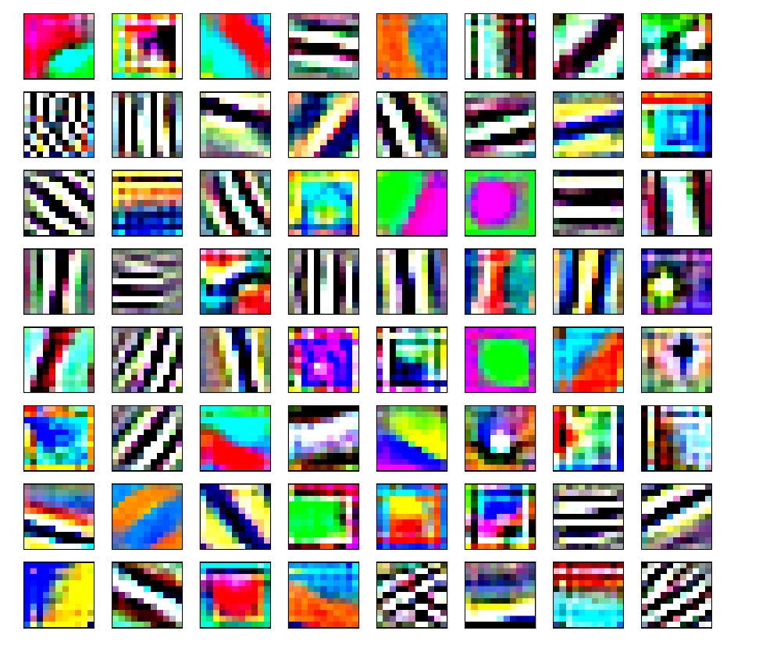
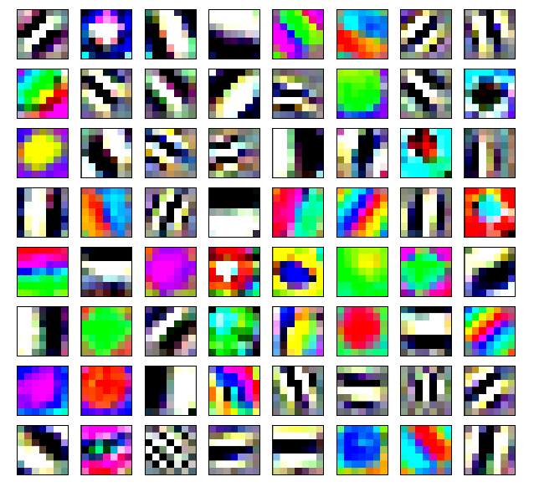
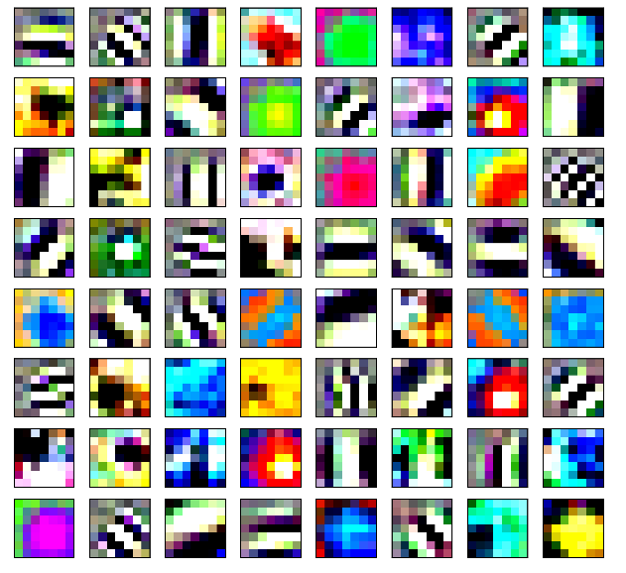
TRANSFER LEARNING
Learn to perform a task in the source domain and use the features to initialize the neural network for the task in the target domain.
First convolutional layer features: Alex Net with 11-by-11 features and Google Net and Resnet101 with 7-by-7 features

Slide 8
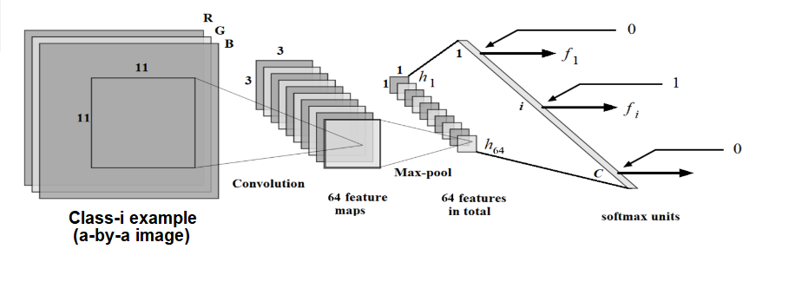
A CNN with one convolutional layer
The figure is for a=19 and stride of 4.
For a=35 and stride of 4, we would have 7x7 feature maps at the output of the Convolution-layer that is computed as: (35-11)//4 + 1 = 7

Slide 9
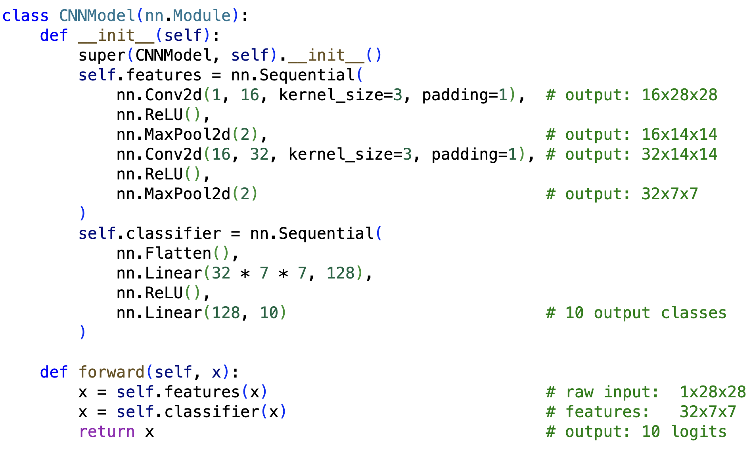
simplest, least robust
Area-1
Area-2
intensity
color
edges
textures
contours
segments
object parts
object
…
Fully connected
(MLP)
most difficult, most robust
https://pytorch.org/vision/stable/_modules/torchvision/models/alexnet.html

Slide 10

CNN WITH 3 AREAS
Predicted Class
Softmax
Global Average Pooling
Conv-3 (with d features) + ReLU + Max-pool
Conv-2 (with d/2 features) + ReLU + Max-pool
Conv-1 (with d/4 features) + ReLU + Max-pool

Slide 11
Convolution
Convolution is filtering an image/tensor A (a-by-a-by-3) using a small filter/mask B. B is a small image itself (w-by-w-by-3) but its pixel values are actually weights.
Filter,
mask or
template
Input
image
Convolved
Image
A
C
B
A_{1,1}
A_{1,2}
A_{1,3}
A_{1,4}
C_{1,1}
C_{1,2}
C_{1,3}
B_{1,1}
B_{1,2}
∗
A_{2,1}
A_{2,2}
A_{2,3}
A_{2,4}
=
C_{2,1}
C_{2,2}
C_{2,3}
B_{2,1}
B_{2,2}
A_{3,1}
A_{3,2}
A_{3,3}
A_{3,4}
C_{3,1}
C_{3,2}
C_{3,3}
2 × 2
A_{4,1}
A_{4,2}
A_{4,3}
A_{4,4}
3 × 3
4 × 4

Slide 12
B_{1,1}
A_{1,1}
B_{1,2}
A_{1,2}
A_{1,3}
A_{1,4}
B_{2,1}
A_{2,1}
B_{2,2}
A_{2,2}
A_{1,1}×B_{1,1}
A_{1,2}×B_{1,2}
A_{2,3}
A_{2,4}
A_{3,1}
A_{3,2}
A_{3,3}
A_{3,4}
A_{2,1}×B_{2,1}
A_{2,2}×B_{2,2}
A_{4,1}
A_{4,2}
A_{4,3}
A_{4,4}
C_{1,1}=
+
+
+
A_{1,1}×B_{1,1}
A_{1,2}×B_{1,2}
A_{2,1}×B_{2,1}
A_{2,2}×B_{2,2}

Slide 13
A_{1,1}
B_{1,1}
A_{1,2}
B_{1,2}
A_{1,3}
A_{1,4}
A_{2,1}
B_{2,1}
A_{1,2}×B_{1,1}
A_{1,3}×B_{1,2}
A_{2,2}
B_{2,2}
A_{2,3}
A_{2,4}
A_{3,1}
A_{3,2}
A_{3,3}
A_{3,4}
A_{2,2}×B_{2,1}
A_{2,3}×B_{2,2}
A_{4,1}
A_{4,2}
A_{4,3}
A_{4,4}
C_{1,2}=
+
+
+
A_{1,2}×B_{1,1}
A_{1,3}×B_{1,2}
A_{2,2}×B_{2,1}
A_{2,3}×B_{2,2}

Slide 14
A_{1,1}
A_{1,2}
B_{1,1}
A_{1,3}
B_{1,2}
A_{1,4}
A_{2,1}
A_{2,2}
B_{2,1}
A_{1,3}×B_{1,1}
A_{1,4}×B_{1,2}
A_{2,3}
B_{2,2}
A_{2,4}
A_{3,1}
A_{3,2}
A_{3,3}
A_{3,4}
A_{2,3}×B_{2,1}
A_{2,4}×B_{2,2}
A_{4,1}
A_{4,2}
A_{4,3}
A_{4,4}
C_{1,3}=
+
+
+
A_{1,3}×B_{1,1}
A_{1,4}×B_{1,2}
A_{2,3}×B_{2,1}
A_{2,4}×B_{2,2}

Slide 15
A_{1,1}
A_{1,2}
A_{1,3}
A_{1,4}
B_{1,1}
A_{2,1}×B_{1,1}
A_{2,2}×B_{1,2}
A_{2,1}
B_{1,2}
A_{2,2}
A_{2,3}
A_{2,4}
B_{2,1}
A_{3,1}
B_{2,2}
A_{3,2}
A_{3,3}
A_{3,4}
A_{3,1}×B_{2,1}
A_{3,2}×B_{2,2}
A_{4,1}
A_{4,2}
A_{4,3}
A_{4,4}
C_{2,1}=
+
+
+
A_{2,1}×B_{1,1}
A_{2,2}×B_{1,2}
A_{3,1}×B_{2,1}
A_{3,2}×B_{2,2}

Slide 16
A_{1,1}
A_{1,2}
B_{1,1}
A_{1,3}
B_{1,2}
A_{1,4}
A_{2,1}
A_{2,2}
B_{2,1}
B_{1,1}
A_{2,3}
B_{2,2}
B_{1,2}
A_{2,4}
A_{3,1}
A_{3,2}
B_{2,1}
B_{1,1}
A_{3,3}
B_{2,2}
B_{1,2}
A_{3,4}
A_{4,1}
A_{4,2}
B_{2,1}
A_{4,3}
B_{2,2}
A_{4,4}

Slide 17
Convolution: A Numerical Example
Filter,
mask or
template
Input
image
Convolved
Image
A
C
B
4
4
7
9
∗
6
23
21
-1
2
4
3
8
9
=
9
26
19
-1
2
3
5
9
9
16
27
17
2 × 2
3
6
10
9
3 × 3
4 × 4

Slide 18
Convolution (feature map) size
Image size = M₁ × N₁
Mask size = M₂ × N₂
N₁
Convolution size =
M₁- M₂ +1 × N₁-N₂+1
N₂
N₁-N₂+1
Typical Mask sizes
= 3×3, 5 ×5, 7×7,
9 ×9, 11×11

Slide 19
Convolution: Mathematical Notation
C_{1,1}=
+
+
+
A_{1,1}×B_{1,1}
A_{1,2}×B_{1,2}
A_{2,1}×B_{2,1}
A_{2,2}×B_{2,2}

Slide 20
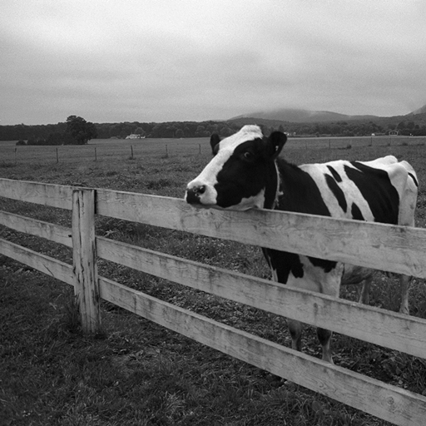

Convolution Application Examples
--Averaging/smoothing
1 1 1
1 1 1
1 1 1
1 1 1
1 1 1
1 1 1
1 1 1
1 1 1
1 1 1
*
1 1 1
1 1 1
1 1 1
1 1 1
1 1 1
1 1 1
1 1 1
1 1 1
1 1 1
=
1 1 1
1 1 1
1 1 1
1 1 1
1 1 1
1 1 1
1 1 1
1 1 1
1 1 1
We convolve with 9*9 averaging filter

Slide 21
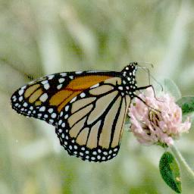
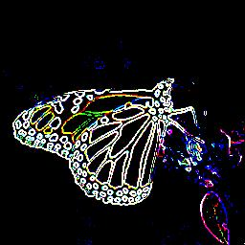
Convolution Application Examples
--Edge Detection with Sobel Operator
-1 -2 -1
0 0 0
1 2 1
-1 0 1
-2 0 2
-1 0 1
S₂ =
S₁=
Edge Magnitude =
(or use ReLU |S₁| + |S₂ | for approximation)

Slide 22
Convolution Application Examples
Sobel masks:
--Edge Detection
Column Mask
-1 -2 -1
0 0 0
1 2 1
Row Mask
-1 0 1
-2 0 2
-1 0 1
p0, p1, p2
p3, p4, p5
p6, p7, p8
-1 2 -1
0 0 0
1 2 1
*
The result of the above calculation for column mask is horizontal difference
With Row Mask we will get vertical difference

Slide 23
Different masks serve as different feature detectors
--Edges via Robinson Compass masks
-1 0 1
-2 0 2
-1 0 1
0 1 2
-1 0 1
-2 -1 0
1 2 1
0 0 0
-1 -2 -1
2 1 0
1 0 -1
0 -1 -2
1 0 -1
2 0 -2
1 1 -1
0 -1 -2
-1 0 -1
2 1 0
-1 -2 -1
0 0 0
1 2 1
-2 -1 0
-1 0 1
0 1 2
Arrows show edge directions

Slide 24
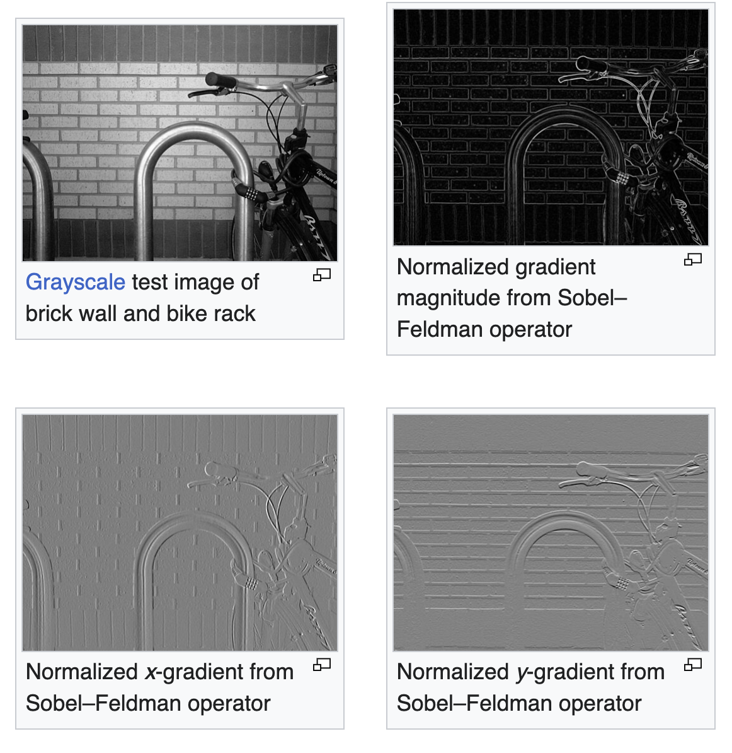
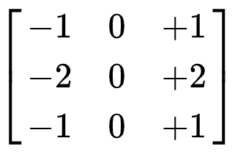
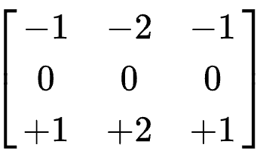
Different masks serve
as different feature detectors
Source for the figure:
https://en.wikipedia.org/wiki/Sobel_operator

Slide 25
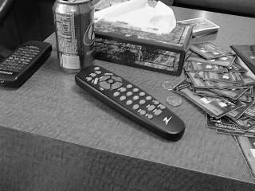
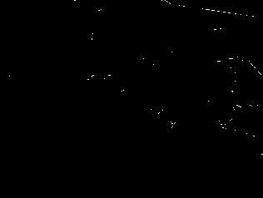
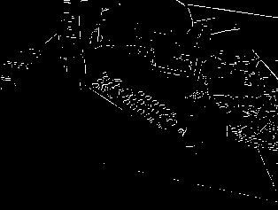
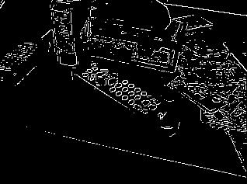
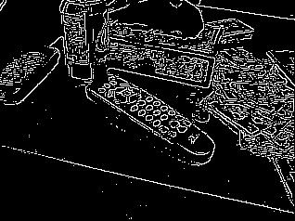
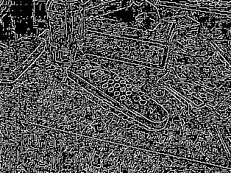
Making sense of ReLU
Get rid of low feature values, keep it if it is really there!
original image
very high threshold
reasonable
too low !

Slide 26
Making sense of Max-Pool
For each mask, the convolution scans the image for detecting its feature, max-pool takes the maximum detection in a neighborhood.
Combined with strides, max-pool keeps that maximum value but loses the precise location to reduce dimensionality (a stride of 2 means 75% dimensionality reduction).
61
62
1
59
1
65
62
59
57
60
1
63
1
56
60
63
M_{1,2}=
63
59
55
58
57
49
53
55
45

